Slide 1
Mechanical Keyboard
simple but precise

Slide 2
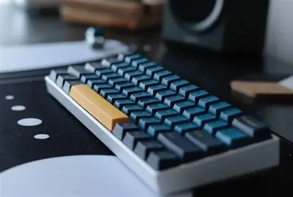
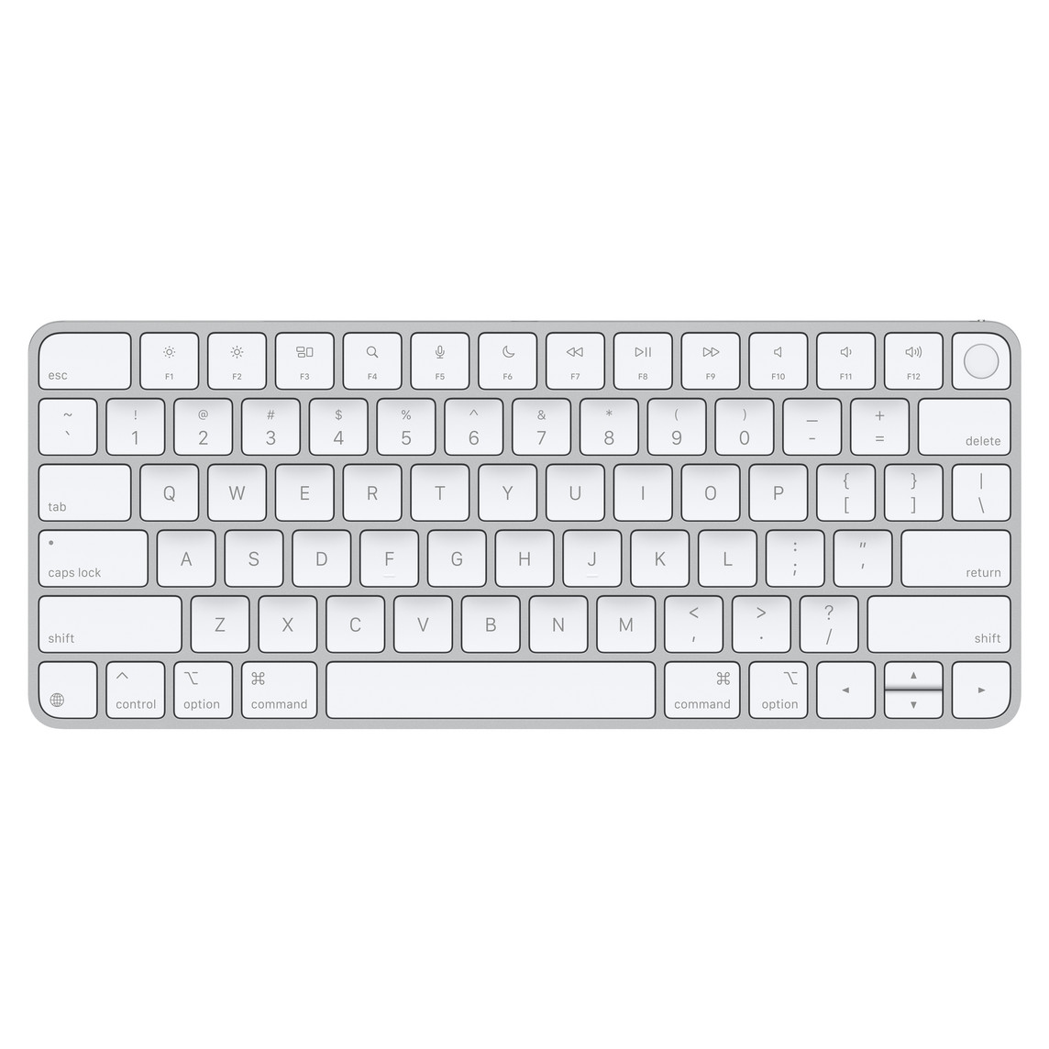
Keyboards
membrane keyboard
mechanical keyboard

Slide 3
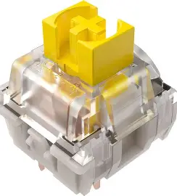
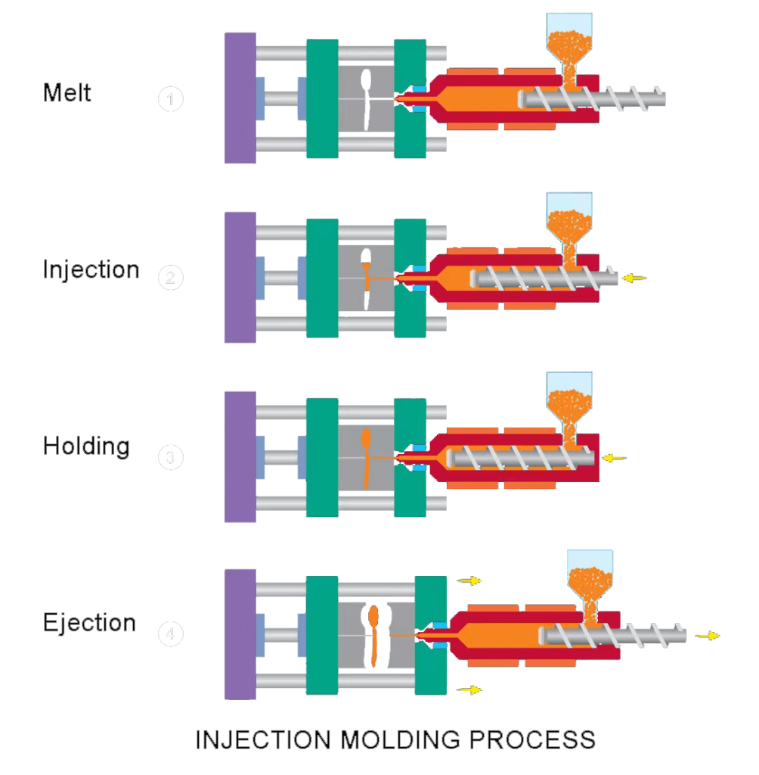
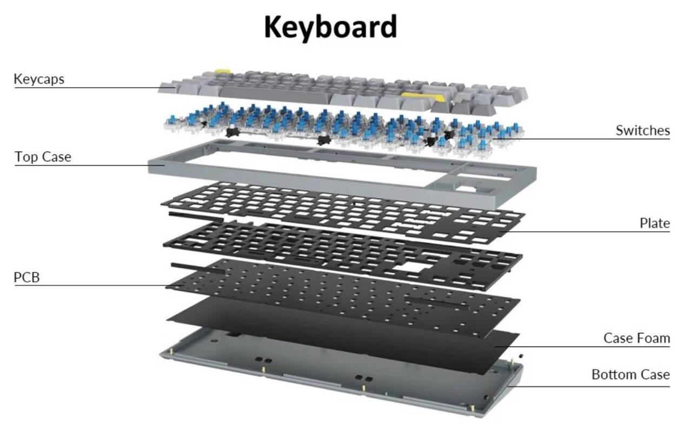
Major Components

Slide 4
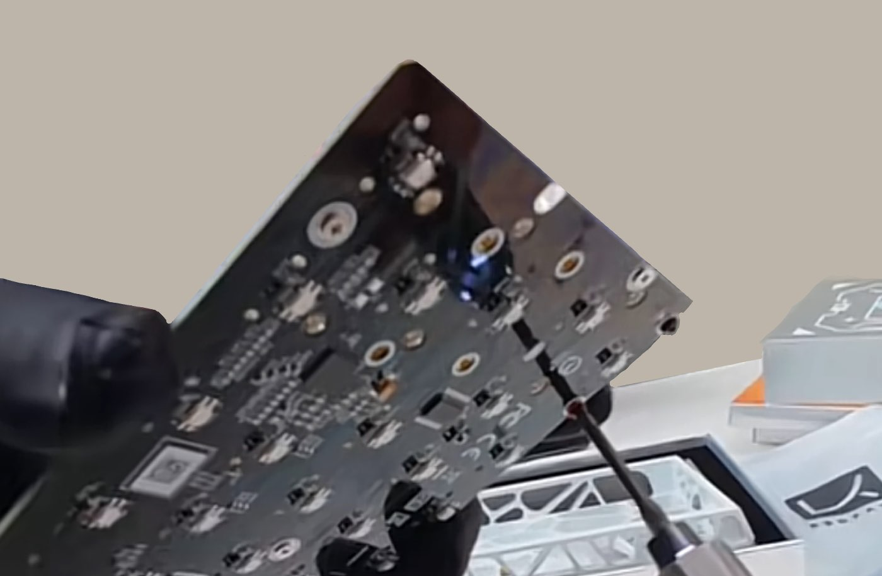
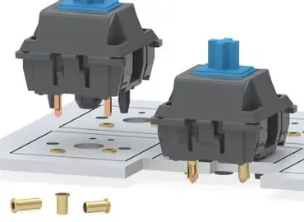
Manufacturing
injection molding
hot-swap sockets
fixing with screws

Slide 5

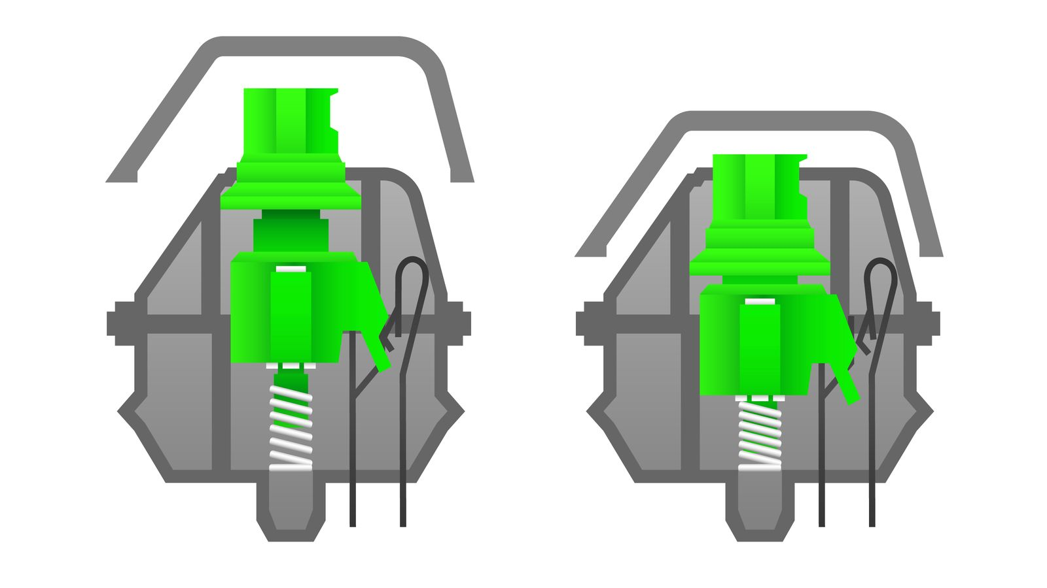
Operation
press
spring
two metal contacts
signal
computer

Slide 6
End of this presentation

